Slide 1
Recycle Connect
Recycle Marketplace

Slide 2
Business Challenge/Opportunity/Usecases
Connecting Waste Generators with Recyclers
Business Challenge: A significant amount of waste is produced worldwide, which is causing environmental concerns. The traditional waste management methods are not enough to handle the waste generated, and there is a need for a sustainable solution to handle this waste effectively.
Opportunity: Developing a digital platform that connects waste generators with recyclers could help address this problem. This platform would create a transparent and accessible market for waste materials and promote circular economy practices.
Use Cases: The recycling marketplace could be used by various industries such as manufacturing, construction, healthcare, and municipal waste management to buy and sell different types of waste materials.

Slide 3
Proposed Solution
A Digital Platform for Sustainable Waste Management
The recycling marketplace is a digital platform that connects waste generators with recyclers, allowing them to buy and sell various waste materials.
The platform uses Microsoft Cloud Technology such as Azure Data, Analytics and AI capabilities to manage the various data, such as waste generation, recycling, and pricing.
The platform offers various features such as search and listing functionality, communication tools, payment gateway integration, and analytics dashboard.

Slide 4
High-Level Architecture
The recycling marketplace platform is built on Microsoft Azure cloud services.
The platform includes a front-end application that allows users to search and list waste materials, a back-end application that manages the data and analytics, and a payment gateway for transactions.
The platform uses Azure Data Lake Storage to store and manage the data and Azure Analysis Services for analytics.
Azure AI services such as Azure Cognitive Services and Azure Machine Learning are used for text and image recognition to ensure accurate waste material classification and pricing.
The platform is secured using Azure Active Directory and Azure Security Center.

Slide 5
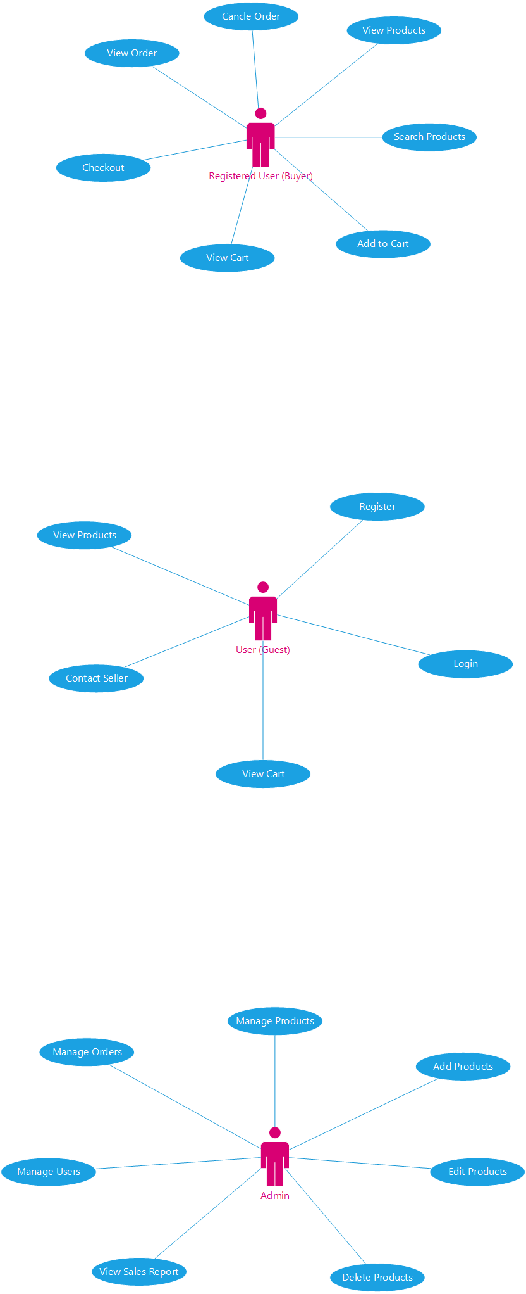
Supporting Diagrams - UseCase

Slide 6
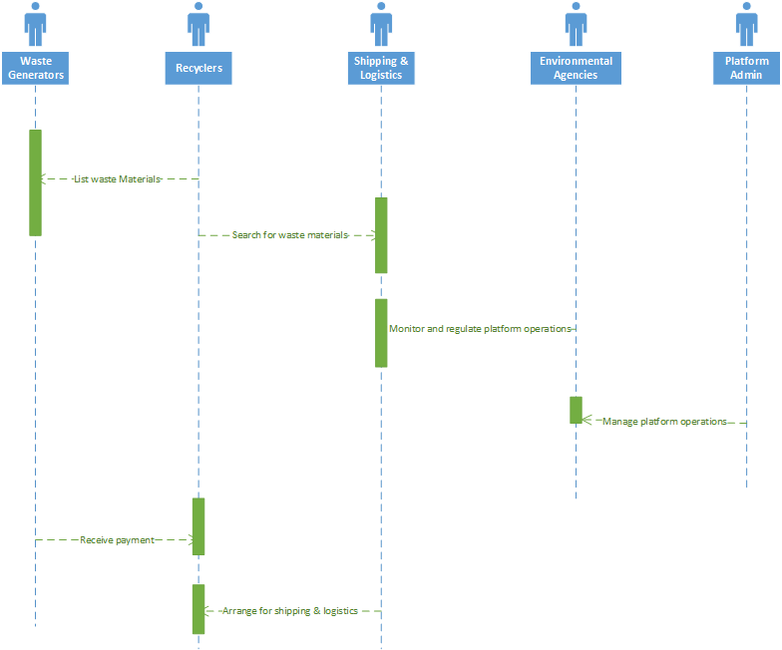
Sequence Diagram
Notes:
Waste Generators: The main actor who generates waste materials and can sell them through the platform.
Recyclers: Actors who can purchase waste materials from the platform and recycle them into new products.
Shipping and Logistics: Actors who can provide shipping and logistics services for the transportation of waste materials from waste generators to recyclers.
Platform Admin: The actor who manages the platform and its features, including user accounts, waste material listings, and partnerships with recyclers and shipping and logistics companies.
Environmental Agencies: Actors who can monitor and regulate the operations of the platform to ensure that it is in compliance with environmental regulations and promotes sustainable waste management practices.

Slide 7
Explanation:
Waste Generators: The main actor who generates waste materials and can sell them through the platform.
Recyclers: Actors who can purchase waste materials from the platform and recycle them into new products.
Shipping and Logistics: Actors who can provide shipping and logistics services for the transportation of waste materials from waste generators to recyclers.
Platform Admin: The actor who manages the platform and its features, including user accounts, waste material listings, and partnerships with recyclers and shipping and logistics companies.
Environmental Agencies: Actors who can monitor and regulate the operations of the platform to ensure that it is in compliance with environmental regulations and promotes sustainable waste management practices.

Slide 8
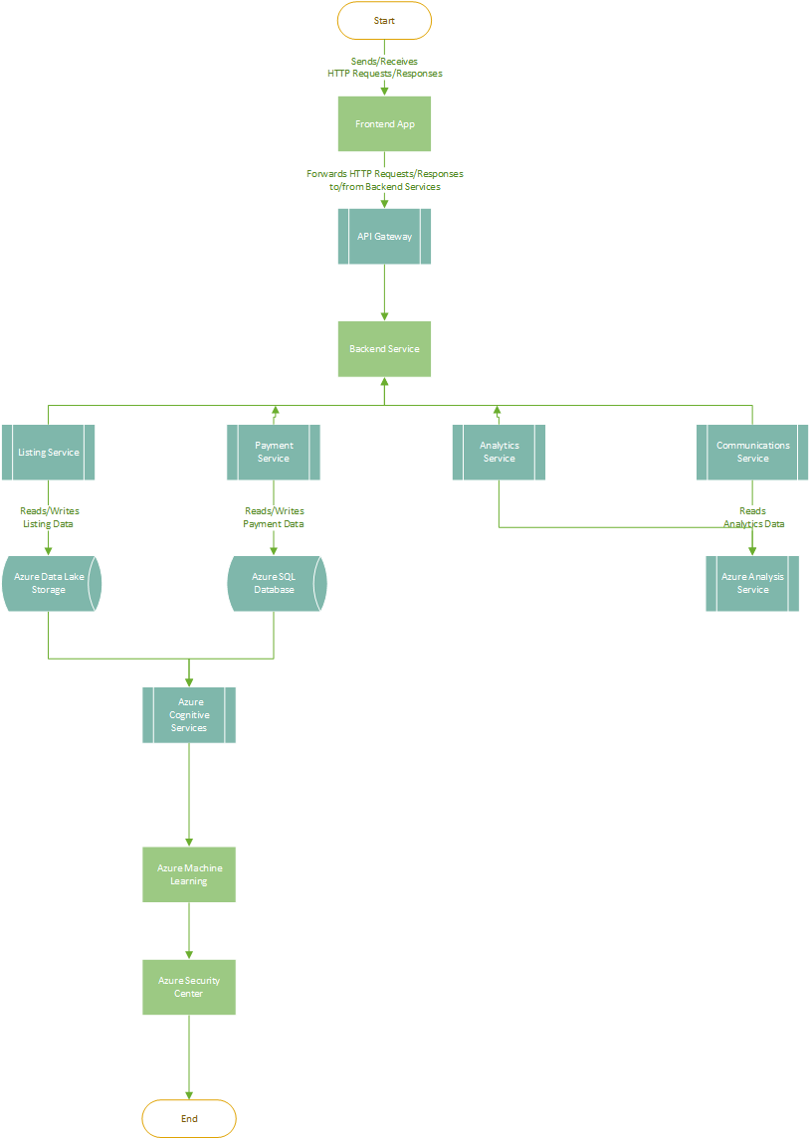
Architecture Diagram
Notes:
Explanation:
The front-end application is the user-facing interface that allows waste generators and recyclers to interact with the platform. It is hosted on Azure App Service.
The back-end application is responsible for managing the data and analytics, as well as handling the business logic of the platform. It is hosted on Azure Virtual Machines and Azure Kubernetes Service (AKS).
Azure Data Lake Storage is used to store and manage the data, such as waste generation, recycling, and pricing information. Azure Analysis Services is used for analytics and reporting, providing insights into waste generation, recycling rates, pricing trends, and user engagement.
Azure Cognitive Services and Azure Machine Learning are used for text and image recognition, ensuring accurate waste material classification and pricing.
Azure Active Directory is used for authentication and authorization, ensuring that only authorized users can access the platform. Azure Security Center provides advanced threat protection and helps ensure compliance with industry standards and regulations.
The payment gateway is used to facilitate transactions between waste generators and recyclers, allowing them to buy and sell various waste materials. It is hosted on Azure Virtual Machines and is integrated with various payment providers to support different payment methods.
Overall, this architecture ensures that the Recycling Marketplace platform is secure, scalable, and can handle large amounts of data, enabling waste generators and recyclers to buy and sell waste materials in a transparent and accessible market.

Slide 9
Explanation:
The front-end application is the user-facing interface that allows waste generators and recyclers to interact with the platform. It is hosted on Azure App Service.
The back-end application is responsible for managing the data and analytics, as well as handling the business logic of the platform. It is hosted on Azure Virtual Machines and Azure Kubernetes Service (AKS).
Azure Data Lake Storage is used to store and manage the data, such as waste generation, recycling, and pricing information.
Azure Analysis Services is used for analytics and reporting, providing insights into waste generation, recycling rates, pricing trends, and user engagement.
Azure Cognitive Services and Azure Machine Learning are used for text and image recognition, ensuring accurate waste material classification and pricing.
Azure Active Directory is used for authentication and authorization, ensuring that only authorized users can access the platform.
Azure Security Center provides advanced threat protection and helps ensure compliance with industry standards and regulations.
The payment gateway is used to facilitate transactions between waste generators and recyclers, allowing them to buy and sell various waste materials. It is hosted on Azure Virtual Machines and is integrated with various payment providers to support different payment methods.
Overall, this architecture ensures that the Recycling Marketplace platform is secure, scalable, and can handle large amounts of data, enabling waste generators and recyclers to buy and sell waste materials in a transparent and accessible market.

Slide 10
Thanks

